Slide 1
Module 5
Managing recipient objects
Notes:
Presentation: 60 minutes
Demonstration: 15 minutes
Lab: 70 minutes
After completing this module, students will be able to:
Describe the different Microsoft Exchange Server 2016 recipients.
Manage Exchange Server 2016 recipients.
Configure address lists and policies.
Required materials
To teach this module, you need the Microsoft PowerPoint file 20345-1A_03.pptx.
Preparation tasks
To prepare for this module:
Read all of the materials for this module.
Practice performing the demonstrations and labs.
Work through the Module Review and Takeaways section, and determine how you will use the information to reinforce student learning and promote knowledge transfer to on-the-job performance.
As you prepare for this class, it is imperative that you complete the labs yourself. This gives you an understanding of how the labs work and the concepts that each covers, so that you can provide meaningful hints to students who might have issues. Furthermore, it will help guide your lecture to ensure that you discuss the concepts that the labs cover.
20345-1A
3: Managing recipient objects

Slide 2
Module Overview
Public Folders
Exchange Server recipients Managing Exchange Server recipients Configuring address lists and policies
Notes:
20345-1A
3: Managing recipient objects

Slide 3
Managing public folder mailboxes
Configuring public folder permissions
Use the Add-PublicFolderClientPermission and Remove-PublicFolderClientPermission cmdlets
Mail-enabling public folders
Use the Enable-MailPublicFolder cmdlet
Managing quota and retention settings
Use the Set-PublicFolder cmdlet
Monitoring public folders
Use the Get-PublicFolderItemStatistics, Get-PublicFolderStatistics, Get-PublicFolderMailboxDiagnostics, Update-PublicFolderMailbox cmdlets
Notes:
Emphasize that most of the management tasks for public folders have not changed in Exchange Server 2016. You can still use Outlook to assign public folder permissions, and the permission options have not changed. You can still mail-enable or disable public folders, and configure the quota and retention settings. The biggest change in managing public folders is that now you can perform most of the tasks in the Exchange Administration Center.
20345-1A
3: Managing recipient objects

Slide 4
Demonstration: Managing public folder mailboxes
In this demonstration, you will see how to:
Create a public folder mailbox
Create a public folder
Configure public folder permissions
Notes:
Leave the virtual machines running after you complete the demonstration.
Preparation Steps
To perform this demonstration, ensure that the 20345-1A-LON-DC1, 20345-1A-LON-EX1, and 20345-1A-LON-EX2 virtual machines are running. If required, sign into all virtual machines by using the Adatum\Administrator account with the password Pa$$w0rd.
Demonstration Steps
On LON-EX1, switch to Exchange Administration Center.
In the Feature pane, click public folders.
Click public folder mailboxes, and then click new public folder mailbox.
On the new public folder mailbox page, type PFMBX1 in the Name text box.
Under Organizational unit, click browse, click IT, and then click ok.
Under Mailbox database, click browse, click Mailbox Database 1 and then click ok.
Click Save.
Perform steps 3 through 7 again to create another public folder mailbox named PFMBX2.
Click public folders, and then click New public folder.
On the new Public Folder dialog box, in the Name text box, type Departments, and then click Save.
Click Departments, and then click New public folder.
In the new Public Folder dialog box, in the Name text box, type IT, and then click Save.
On the Start screen, click Exchange Management Shell.
At the command prompt, type get-publicfolder –recurse | FL, and then press Enter. Review the information displayed about each public folder.
20345-1A
3: Managing recipient objects

Slide 5
LAB 5: Public Folder

Slide 6
Lesson 1: Exchange Server recipients
Types of Exchange Server recipients What are resource mailboxes? What are site mailboxes? What are public folder mailboxes? What are distribution groups? What are linked mailboxes?
Notes:
20345-1A
3: Managing recipient objects

Slide 7
Types of Exchange Server recipients
User mailboxes
Mail contacts
Mail users
Resource mailboxes
Shared mailboxes
Mail-enabled security and distribution groups
Dynamic distribution groups
Linked mailboxes
Remote mailboxes
Site mailboxes
Notes:
Explain the different types of Exchange Server recipients. It is important that the students understand each recipient type, because creating and configuring recipients are common and fundamental tasks that Exchange Server administrators perform.
Consider presenting this topic in a question-and-answer format, in which you ask the students to define each type of recipient. This will help you to evaluate student knowledge, and will encourage the students to interact. Inform the students that each of the Exchange Server recipients will be covered in more detail later in the module.
20345-1A
3: Managing recipient objects

Slide 8
What are resource mailboxes?
Mailboxes that represent meeting rooms or shared equipment, and that you can include as resources in meeting requests
To create a resource mailbox:
Create a new mailbox as a room or equipment mailbox
Configure the resource properties
Notes:
Ask the students whether they will need to change the default settings for how resource mailboxes respond to meeting requests. In most organizations, the default settings will be acceptable for most meeting rooms, but most organizations have some meeting rooms that have special requirements. Ask the students to provide some examples, and in the next lesson, inform the students how you could configure room mailboxes to address their scenario.
Question
Your organization coordinates schedules of resources and equipment with outside partners. You want to provide a solution that allows anyone from outside the organization who has an Internet browser to view the scheduling information without deploying additional software. How might you accomplish this?
Answer
You can enable Internet calendar publishing in your Exchange 2016 organization for the resource mailboxes by using a sharing policy to support Anonymous domains.
20345-1A
3: Managing recipient objects

Slide 9
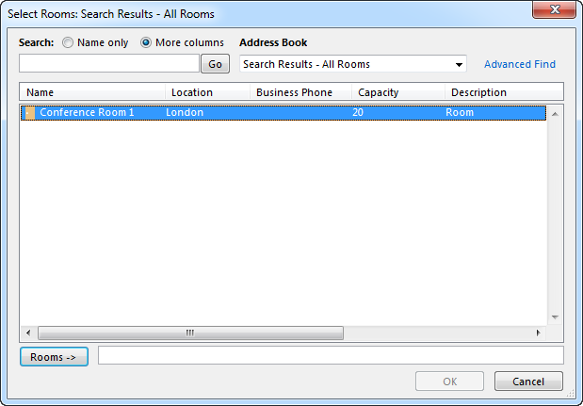
What are resource mailboxes?
Outlook Address Book of a conference room
Notes:
20345-1A
3: Managing recipient objects

Slide 10

What are site mailboxes?
Compliance
Clients
Owners
Members
Site Mailbox
Outlook
SharePoint
Management
Membership
Shared storage
Owners
Members
Provisioning lifecycle
Exchange site mailbox
SharePoint site
Notes:
Make it clear to the students that most of the work in configuring site mailboxes is done in SharePoint Server 2016. For more information, refer to Configure site mailboxes in SharePoint Server 2013 at http://aka.ms/fdrdud to provide details on how to configure the integration of Exchange Server 2013 and SharePoint Server 2016 to enable site mailboxes.
Also emphasize that site mailboxes are only available with Outlook 2013, Exchange Server 2013, and SharePoint Server 2016 and later versions.
20345-1A
3: Managing recipient objects

Slide 11
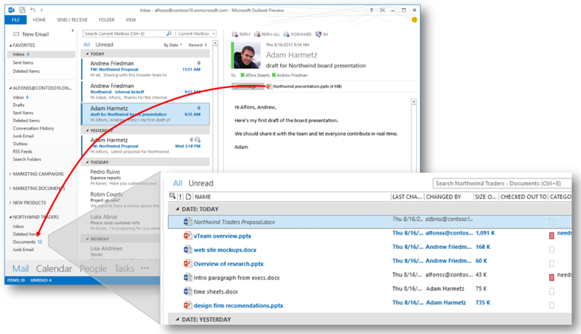
What are site mailboxes?(continued)
Site mailbox in Outlook
Notes:
20345-1A
3: Managing recipient objects

Slide 12
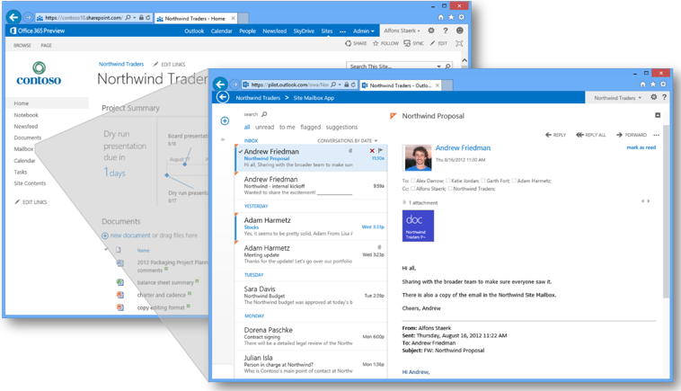
What are site mailboxes? (continued)
Site mailbox in SharePoint
Notes:
20345-1A
3: Managing recipient objects

Slide 13
What are public folder mailboxes?
The underlying architecture for public folders has changed, without significantly altering the user experience. For example:
Public folders are stored in a special type of mailbox called a public folder mailbox.
Public folder mailboxes can be stored in mailbox databases that are part of a DAG.
Public folders are spread across multiple public folder mailboxes.
Notes:
20345-1A
3: Managing recipient objects

Slide 14
What are distribution groups?
Distribution groups are mail-enabled groups that appear in the GAL
Distribution groups are used to:
Send messages to multiple users at one time
Assign permissions to Exchange objects
Distribution groups can be:
Mail-enabled universal security groups
Mail-enabled universal distribution groups
Dynamic distribution groups are mail-enabled groups in which the membership list is calculated based on user attributes when a message is sent to the group
Notes:
Ask the students to describe the difference between security groups and distribution groups. Discuss the implications of mail-enabling security groups. For example, security groups can be used to provide access to network resources, so the membership of security groups is usually controlled strictly. The same groups might or might not have the right membership for email distribution.
20345-1A
3: Managing recipient objects

Slide 15
What are linked mailboxes?
Provide mailboxes for users in separate, trusted forests
Mailboxes can be used in:
Resource forest scenarios
Merger and acquisition scenarios
Requirements:
The domain where Exchange Server is deployed must trust the user account domain
The user account must exist in the user account domain
A two-way trust is recommended to simplify administration
Notes:
20345-1A
3: Managing recipient objects

Slide 16


What are linked mailboxes? (continued)
Linked mailboxes
Provisioning
process
Forest A
Exchange Server
forest
Domain
Trust
Domain
Exchange
server
User01
User02
GAL
-User01
-User02
User01
mailbox
User02
mailbox
Notes:
20345-1A
3: Managing recipient objects

Slide 17
Lesson 2: Managing Exchange Server recipients
Managing mailbox settings Demonstration: Managing mailbox settings Managing distribution groups Managing resource mailboxes Demonstration: Creating and managing resource mailboxes What is a shared mailbox? Demonstration: Creating a shared mailbox Managing mail contacts and mail users Using Send As and Send On Behalf permissions Managing public folder mailboxes Demonstration: Managing public folder mailboxes
Notes:
20345-1A
3: Managing recipient objects

Slide 18
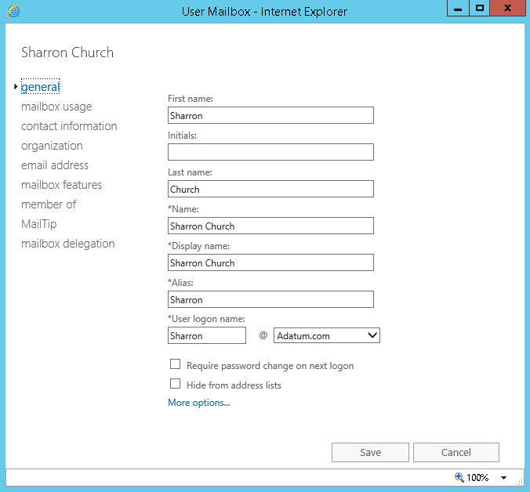
Managing mailbox settings
To create a new mailbox and user account, use the New-Mailbox cmdlet
To configure an existing user account with a mailbox, use the Enable-Mailbox cmdlet
Notes:
Do not spend too much time on this slide. Instead, move on to the next topic, which is a demonstration that covers many of the configuration options mentioned in this topic.
20345-1A
3: Managing recipient objects

Slide 19
Demonstration: Managing mailbox settings
In this demonstration, you will see how to:
Create a user mailbox
Configure user mailbox settings
Delete and disable user mailboxes
Create mailboxes by using the Exchange Management Shell
Notes:
Leave the virtual machines running after you complete the demonstration.
Preparation Steps
To perform this demonstration, ensure that the 20345-1A-LON-DC1, 20345-1A-LON-EX1 and 20345-1A-LON-EX2 virtual machines are running. Start each virtual machine and sign in to it before starting the next virtual machine. Sign into all virtual machines by using the Adatum\Administrator account with the password Pa$$w0rd.
Important: Ensure that you start your virtual machines at least 10 minutes prior to conducting the demonstration. Demonstration Steps
On LON-EX1, click Start, click Internet Explorer, type https://lon-ex1.adatum.com/ecp in the address bar, and then press Enter.
Sign in as Adatum\Administrator by using the password Pa$$w0rd.
On the Choose your preferred display language and home time zone below, in the Time Zone menu, select your time zone, and then click Save.
In the Feature pane, click recipients.
On the toolbar, click New, and then click User mailbox.
In the new user mailbox dialog box, fill in the following information:
Alias: Alice
New User: Click New user
First name: Alice
Last name: Ciccu
Organizational unit: click browse, in the select an organizational unit dialog box, click Research, and then click ok.
20345-1A
3: Managing recipient objects
(More notes on the next slide)

Slide 20
Managing distribution groups
Exchange Server 2016/2019 provides the following options for enabling self-service distribution group management:
Assign non-Exchange administrators as distribution group owners
Enable open-distribution group memberships.
For security distribution groups, configure the group to require owner approval to join groups
For distribution groups that are not security groups, you can configure the group membership as open, which means that anyone can join or leave the group automatically
Enable users to create and manage their own distribution groups
Notes:
20345-1A
3: Managing recipient objects

Slide 21
Managing resource mailboxes
Primary options when configuring a resource mailbox:
Delegates
Booking options
Considerations for planning resource mailboxes:
Who can schedule a resource mailbox
When users can schedule the resource mailbox
How to configure the automatic acceptance policy for the resource mailbox
Notes:
Question
When configuring multiple delegates for a resource mailbox, you can specify a group instead of multiple users. What are the requirements for a resource delegate group?
Answer
A resource delegate group should be a mail-enabled security group.
20345-1A
3: Managing recipient objects

Slide 22
Demonstration: Creating and managing resource mailboxes
In this demonstration, you will see how to:
Create and configure a resource mailbox
Configure a delegate for a resource mailbox
Notes:
Leave the virtual machines running after you have completed the demonstration.
Preparation Steps
Virtual machines 20345-1A-LON-DC1, 20345-1A-LON-EX1, 20345-1A-LON-EX2, 20345-1A-LON-CL1 are required to complete this demonstration. Sign in to the virtual machines as Adatum\Administrator with the password Pa$$w0rd. Do not sign in to LON-CL1 until directed to do so.
Demonstration Steps
On LON-EX1, in the Exchange Administration Center, on recipients, click the resources page.
Click the drop-down arrow next to New, and then click Room mailbox.
Fill in the following information:
Room name: Conference Room 1
Alias: ConferenceRoom1
Organizational unit: Click browse, click Sales, and then click ok.
Location: London
Capacity: 20
Click more options, under Mailbox database, click browse, click Mailbox Database 1, and then click ok.
Click save.
On the resources tab, click Conference Room 1, and then click Edit.
Click booking options.
In the Maximum booking lead time (days) text box, type 365.
In the If you want the meeting organizer to receive a reply, enter the text below text box, type You have successfully booked Conference Room 1.
20345-1A
3: Managing recipient objects

Slide 23
What is a shared mailbox?
Use shared mailboxes to provide multiple users access to a common mailbox
You can create shared mailboxes in a single step in the Exchange Administration Center or Exchange Management Shell
You can grant users Full Access and Send As permissions
Notes:
Highlight the difference between how shared mailboxes are implemented in Exchange Server 2016 compared to previous versions of Exchange Server prior to Exchange Server 2013. In the previous versions, you could create a mailbox and grant other users Full Access, Send As, or Send on Behalf of permissions. You could even disable the user account associated with the mailbox.
In Exchange Server 2016, the shared mailbox enables you to do exactly the same thing; the only difference is that now you can configure these settings automatically when you create the shared mailbox. Inform students who might be upgrading from Exchange Server 2010 that they can manage shared mailboxes in a separate tab in the Exchange admin center in Exchange Server 2016.
20345-1A
3: Managing recipient objects

Slide 24
Demonstration: Creating a shared mailbox
In this demonstration, you will see how to create and configure a shared mailbox
Notes:
Leave all virtual machines running for subsequent demonstrations.
Preparation Steps
To perform this demonstration, ensure that the 20345-1A-LON-DC1, 20345-1A-LON-EX1, 20345-1A-LON-EX2, and 20345-1A-LON-CL1 virtual machines are running. If necessary, sign into all virtual machines by using the Adatum\Administrator account with the password Pa$$w0rd.
Demonstration Steps
On LON-EX1, switch to Exchange Administration Center, click the shared tab, and then click New.
Fill in the following information:
Display name: Sales Information
Alias: salesInfo
Organizational unit: Sales
Under Users, click Add, click Nate Sun, and then click add.
Click Amr Zaki, click add, and then click ok.
Click more options.
Under Mailbox database, click browse, click Mailbox Database 1, and then click ok.
Click save.
In Internet Explorer, type https://lon-ex1.adatum.com/owa in the address bar, and then press Enter.
On the sign in page, sign in as Adatum\Administrator with the password Pa$$w0rd.
Click New.
Create a new message with the recipient Sales Information and the subject Information request, and then send the message.
20345-1A
3: Managing recipient objects

Slide 25
Managing mail contacts and mail users
Mail contacts:
Mail-enabled AD DS contacts
Listed in the GAL
Provide email addresses for users or groups that exist outside the Exchange organization
Mail users:
Similar to mail contacts, but mail users have AD DS security identifiers
Can access resources in the local domain, but email is sent to external messaging systems
Notes:
20345-1A
3: Managing recipient objects

Slide 26
Using Send As and Send On Behalf permissions
After Send As permission is assigned to a delegate, any message that the delegate sends from the mailbox will appear to have been sent by the mailbox owner
After Send On Behalf permission is assigned to a delegate, the From address sent by the delegate indicates that the message was sent by the delegate on behalf of the mailbox owner
Permissions can be assigned to user mailboxes, linked mailboxes, resource mailboxes, shared mailboxes, distribution groups, dynamic distribution groups, and mail-enabled security groups
Notes:
Emphasize that while the permissions are granted differently for Send As and Send On Behalf, the delegate will use the same procedure for both when sending an email from the mailbox owner.
20345-1A
3: Managing recipient objects

Slide 27
Lesson 3: Configuring address lists and policies
What are address lists? Demonstration: Configuring address lists Configuring offline address books What are address book policies? Demonstration: Configuring address book policies What are email-address policies? Demonstration: Configuring email address policies
Notes:
20345-1A
3: Managing recipient objects

Slide 28
What are address lists?
Recipient objects that are grouped together based on an LDAP query for specific AD DS attributes
Address lists can simplify the process of locating recipients in the GAL
Default address lists include:
All Contacts
All Groups
All Rooms
All Users
Public Folders
Default Global Address List
Notes:
Explain that address lists are recipient objects that are grouped together based on an LDAP query for specific Active Directory attributes.
Mention that address lists sort the GAL into multiple views, which makes it easier to locate recipients. This is especially helpful for very large or highly segmented organizations.
Explain that address lists are configured with recipient filters that determine which objects belong in each address list, similar to the way that you configure email address policies.
20345-1A
3: Managing recipient objects

Slide 29
Demonstration: Configuring address lists
In this demonstration, you will learn how to create and configure address lists
Notes:
Leave the virtual machines running after you complete the demonstration.
Preparation Steps
To perform this demonstration, ensure that the 20345-1A-LON-DC1, 20345-1A-LON-EX1, 20345-1A-LON-EX2, and 20345-1A-LON-CL1 virtual machines are running. Sign into all the server virtual machines by using the Adatum\Administrator account with the password Pa$$w0rd. Sign into LON-CL1 as Adatum\Nate using the password Pa$$w0rd.
Demonstration Steps
On LON-EX1, switch to the Exchange Admin Center.
In the left navigation pane, click organization, click the address lists tab, and then click New.
In the new address list window, type All Departments in the Name text box.
Click only the following recipient types, select Users with Exchange mailboxes, click Save, and then click OK in the warning dialog box.
Click New.
In the new address list window, type Research in the Name text box.
Next to the Address list path, click Browse.
In the Address List Picker window, click All Departments, and then click OK.
In the new address list window, click Only the following recipient types, and then select Users with Exchange mailboxes.
Click add a rule, from the new drop-down menu, click Select one, and then click Department.
In the specify words or phrases dialog box, type Research, click Add, and then click OK.
Click Preview recipients the address list includes, verify that only members of the Research department are listed, and then click Close.
20345-1A
3: Managing recipient objects

Slide 30
Configuring offline address books
The offline address book is cached on the local client so that users can search the GAL when disconnected from Exchange Server
The default offline address book contains the entire GAL
Can configure custom offline address books that contain smaller address lists
The offline address book:
Is generated on the Mailbox server that hosts the Organization mailbox
Is distributed through web services using the OAB virtual directory
Notes:
Point out the significant differences in how the offline address books are generated and configured in Exchange Server 2016 compared to earlier versions of Exchange Server. The main differences are:
In previous versions, you could modify the offline address book generation server by using the Exchange administration tools. In Exchange Server 2016, the only way to change which server will generate the offline address book is to move the Organization mailbox to another Mailbox server.
In previous versions of Exchange, you could distribute the offline address book through the OAB virtual directories, or through public folders. You cannot configure Exchange Server 2016 to distribute the offline address book through public folders.
In previous versions of Exchange, you could manage the offline address book by using the graphical administration tools. In Exchange Server 2016, you can only manage the offline address book by using the Exchange Management Shell.
You should also point out that the Client Access service on the Mailbox server in Exchange Server 2016 replaces the Client Access Server role in previous versions of Exchange Server.
20345-1A
3: Managing recipient objects

Slide 31
What are address book policies?
Address book policies can limit the information that users see in their GAL
In Exchange Server 2016, you can use address book policies to configure GAL segmentation
Address book policies only apply when the user’s mailbox is located on an Exchange Server 2010 Service Pack 3 (SP3) server, Exchange Server 2013 server, or Exchange Server 2016/2019 server
If a user accesses the global address list through a direct LDAP query to a global catalog server, the address book policy do not apply
Notes:
Describe how the address book policy is created from the different components on the slide.
20345-1A
3: Managing recipient objects

Slide 32
What are address book policies?
Scenario:
An organization has two divisions in the same Exchange organization
Users should see only other users in their division in the GAL
Notes:
20345-1A
3: Managing recipient objects

Slide 33

What are address book policies?
Address Lists
Offline Address Books
Global Address Lists
Room Address Lists
Div1 OAB +Div1 Users +Div1 Contacts + Div2 Users
Div1 GAL
Div1 Room AL
Div1 Users
Div1 DLs
Div1 Contacts
Div1 OAB
Div2 OAB +Div1 Users + Div1 DLs +Div2 DLs + Div 2 Contacts + Div1 GAL
Div2 GAL
Div2 Room AL
Div2 Users
Div2 DLs
Div2 Contacts
Div2 OAB
Notes:
20345-1A
3: Managing recipient objects

Slide 34
What are address book policies?
Division1 ABP
Address Lists
Div1 Users
Div1 DLs
Div1 Contacts
Offline Address Book
Div1 OAB
Default Address List
Div1 GAL
Room Address List
Div1 Room AL
Effective Filter = Div1 GAL
Address Lists
Offline Address Books
Global Address Lists
Room Address Lists
Div1 OAB +Div1 Users +Div1 Contacts + Div2 Users
Div1 GAL
Div1 Room AL
Div1 Users
Div1 DLs
Div1 Contacts
Div1 OAB
Div2 OAB +Div1 Users + Div1 DLs +Div2 DLs + Div 2 Contacts + Div1 GAL
Div2 GAL
Div2 Room AL
Div2 Users
Div2 DLs
Div2 Contacts
Div2 OAB
Notes:
20345-1A
3: Managing recipient objects

Slide 35

What are address book policies?
Division1 ABP
Address Book Policy Assignment
Address Lists
Div1 Users
Div1 DLs
Div1 Contacts
Address Book Policy A
Offline Address Book
Div1 OAB
User
Default Address List
Div1 GAL
Room Address List
Div1 Room AL
Effective Filter = Div1 GAL
Address Lists
Offline Address Books
Global Address Lists
Room Address Lists
Div1 OAB +Div1 Users +Div1 Contacts + Div2 Users
Div1 GAL
Div1 Room AL
Div1 Users
Div1 DLs
Div1 Contacts
Div1 OAB
Div2 OAB +Div1 Users + Div1 DLs +Div2 DLs + Div 2 Contacts + Div1 GAL
Div2 GAL
Div2 Room AL
Div2 Users
Div2 DLs
Div2 Contacts
Div2 OAB
Notes:
20345-1A
3: Managing recipient objects

Slide 36
Demonstration: Configuring address book policies
In this demonstration, you will see how to:
Configure a GAL
Configure an offline address list
Configure an address book policy
Notes:
Leave the virtual machines running for the final demonstration.
Preparation Steps
To perform this demonstration, ensure that the 20345-1A-LON-DC1, 20345-1A-LON-EX1, 20345-1A-LON-EX2, and 20345-1A-LON-CL1 virtual machines are running. If required, sign into all server virtual machines by using the Adatum\Administrator account with the password Pa$$w0rd. Do not sign into LON-CL1 until instructed to do so.
Demonstration Steps
On LON-EX1, switch to Exchange Management Shell.
At the command prompt, type the following command, and press Enter to create the Global Address List.
New-GlobalAddressList -Name ResearchGAL –ConditionalDepartment Research –IncludedRecipients AllRecipients
At the command prompt, type the following command, and press Enter to update the recipient list of the Global Address List.
Update-GlobalAddressList -Identity ResearchGAL
At the command prompt, type the following command, and press Enter to create the Offline Address Book.
New-OfflineAddressBook -Name "ResearchOAB" -AddressLists "ResearchGAL"
At the command prompt, type the following command, and press Enter to create the address book policy.
New-AddressBookPolicy -Name ResearchABP -AddressLists “\All Departments\Research” -OfflineAddressBook ResearchOAB -GlobalAddressList ResearchGAL -RoomList "\All Rooms"
20345-1A
3: Managing recipient objects

Slide 37
What are email-address policies?
Email-address policies automate the process of assigning email addresses to recipients
Email-address policies define the format for the email address
Can assign SMTP and non-SMTP addresses
Can configure both the local and domain components
Email-address policies define the recipients to whom the policy applies
Can filter based on recipient scopes and custom attributes
Notes:
20345-1A
3: Managing recipient objects

Slide 38
Demonstration: Configuring email-address policies
In this demonstration, you will see how to:
Modify the default email-address policy
Create a new email-address policy
Notes:
Revert all virtual machines.
Preparation Steps
To perform this demonstration, ensure that the 20345-1A-LON-DC1, 20345-1A-LON-EX1, 20345-1A-LON-EX2, and 20345-1A-LON-CL1 virtual machines are running. Sign into all virtual machines by using the Adatum\Administrator account with the password Pa$$w0rd.
Before starting this demonstration, complete the following step.
On LON-EX1, in the Exchange Management Shell, type the following command, and then press Enter.
Get-User –OrganizationalUnit Sales | Enable-Mailbox –Database “Mailbox Database 1”
You can ignore the warnings regarding Conference Room 1 and Sales Information. These accounts are already mailbox enabled.
Demonstration Steps
On LON-EX1, switch to the Exchange Administration Center.
In the left navigation pane, click mail flow, and then click the email address policies tab.
Double-click Default Policy.
In the Default Policy window, click email address format, and then click Add.
In the email address format window, click John.Smith@contoso.com, and then select Make this format the reply email address.
Click Save twice. In the warning dialog box, click OK.
In the Details pane, click Apply, and then click yes.
Click Close.
On the accepted domains tab, click New.
In the new accepted domain window, type Sales as the Name, and sales.adatum.com as the Accepted domain, and then click Save.
20345-1A
3: Managing recipient objects

Slide 39
LAB 6: Empfänger

